Slide 1
Title
Creating a Calculator in Python with Tkinter
Presenter's Name – Sapna Kharche
Date – 15-3-2024

Slide 2
Project Overview
To develop a basic calculator with arithmetic operations using Python and Tkinter

Slide 3
Problem Statement
To Create a user-friendly calculator interface capable of performing arithmetic operations

Slide 4
Solution
Utilize Tkinter library for GUI development
Implementing basic arithmetic functions such as addition, subtraction, multiplication, and division
Import Tkinter library
Create the main window
Design the layout with buttons and display screen
Implement event handling for button clicks
Define functions for arithmetic operations
Using ‘Entry’ widgets Integrate the logic for displaying results

Slide 5
Key Features
Basic arithmetic operations: addition, subtraction, multiplication, and division
Clear display of input and output
Ability to clear the screen and perform consecutive calculations

Slide 6
Results and Achievements
Successful implementation of a functional calculator application
Understanding of GUI programming concepts

Slide 7
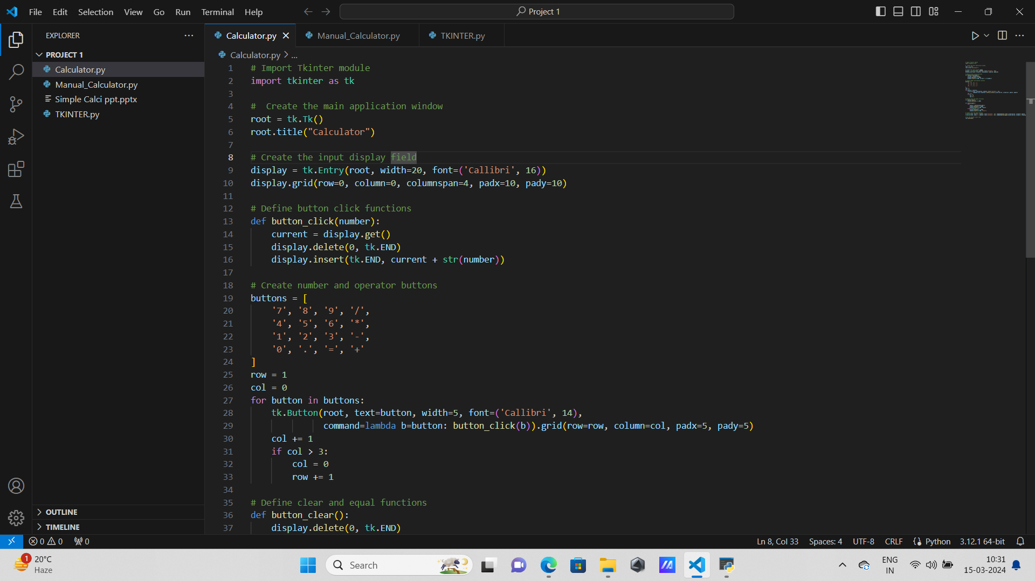
Process of creating a calculator using tkinter

Slide 8
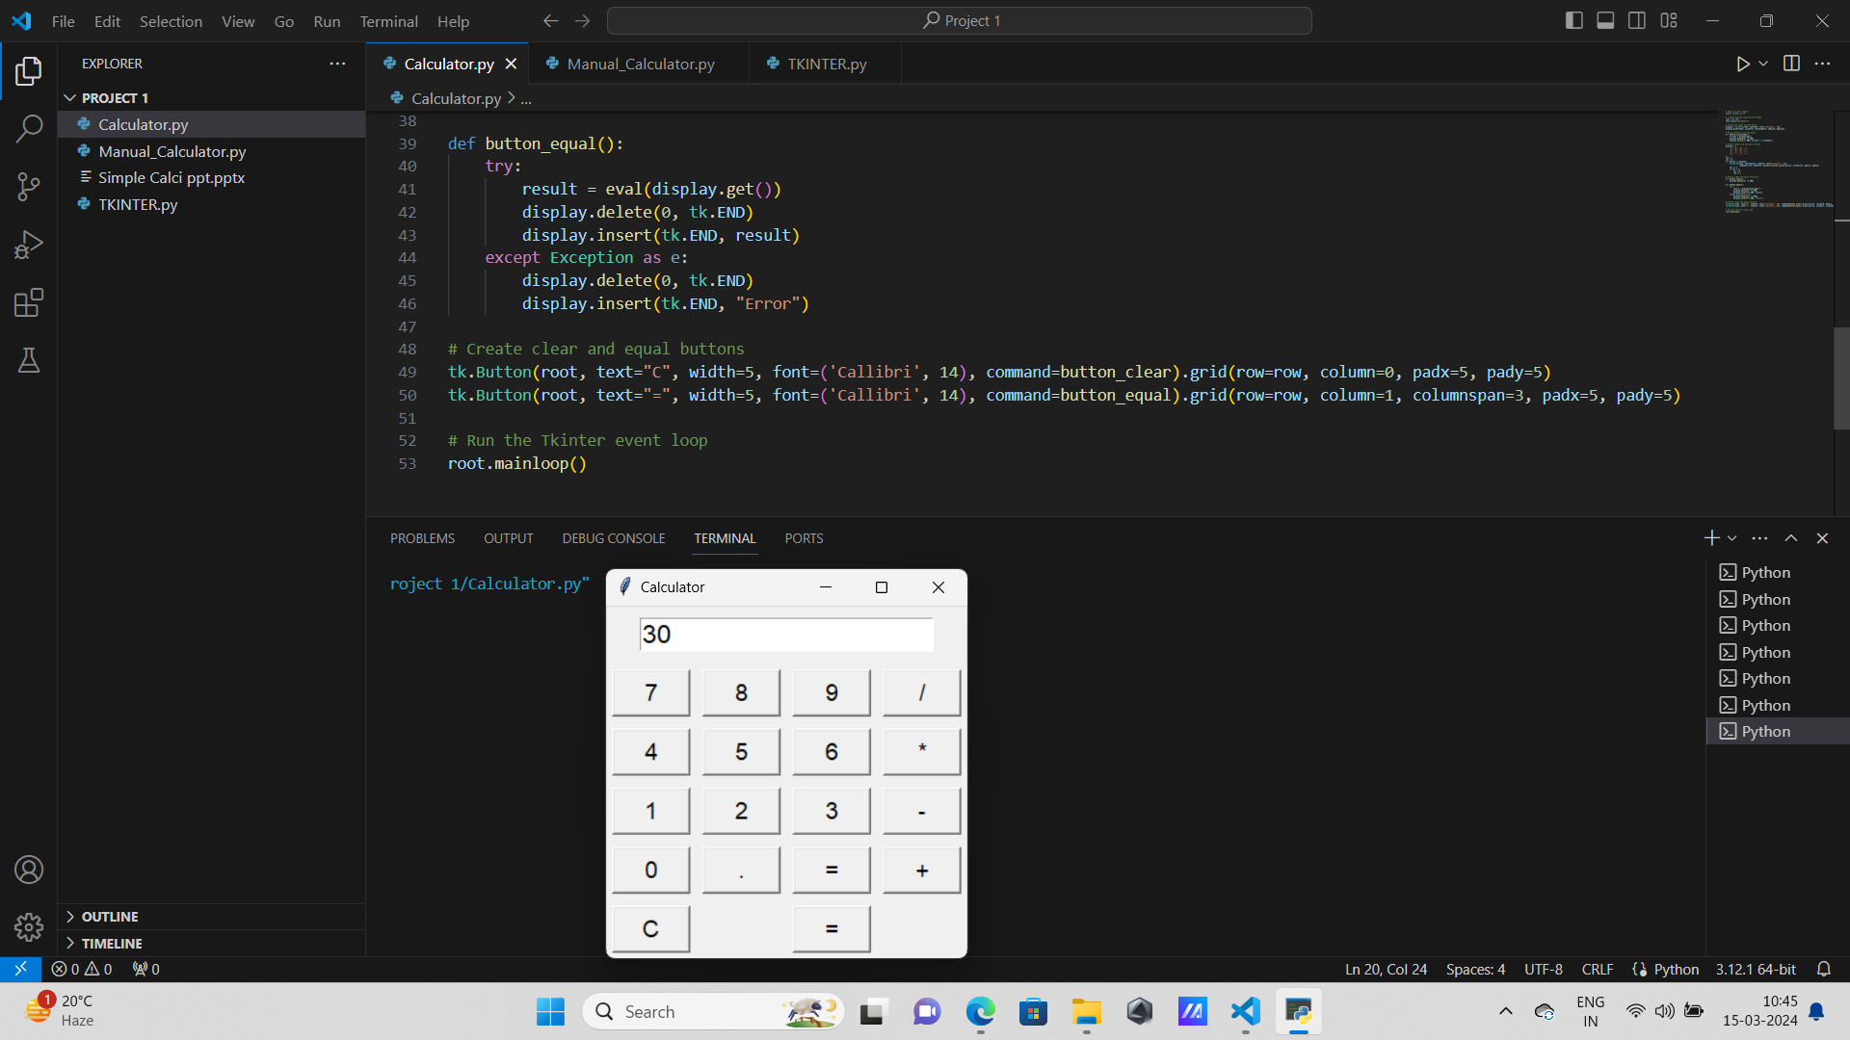
Output

Slide 9
Conclusion
Developed a basic calculator application using Python and Tkinter
Encouraged for further exploration and experimentation with Tkinter
Ready to tackle more complex GUI projects and applications in the future

Slide 10

THANK YOU

